Slide 1
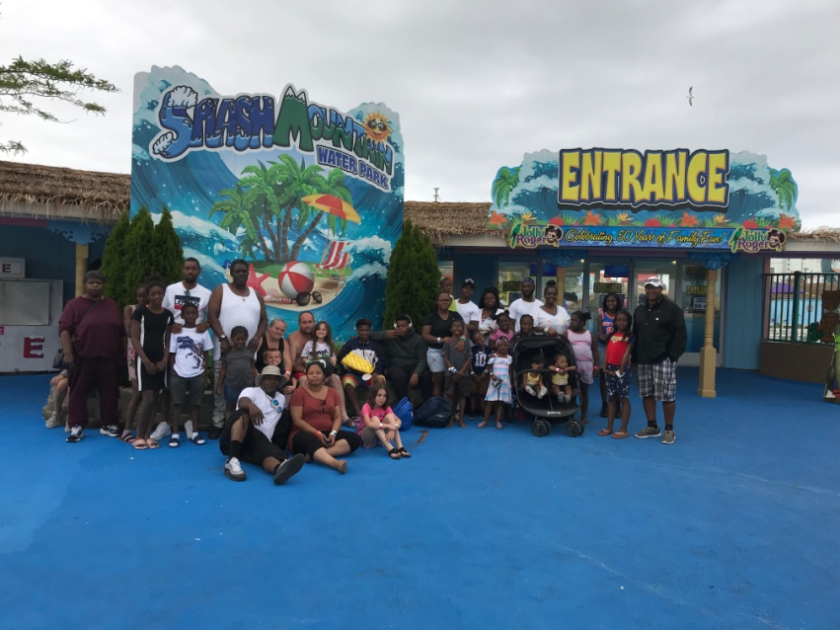
Rules of Engagement
Working Regionally to lift families up while
Increasing Collections
Dawn Coleman, Assistant Director Talbot County Office of Child Support

Slide 2


Slide 3

Fatherhood Programs
Baltimore County Winning Fathers Program
Baltimore County CCBC Job Network Program
Caroline County Parents as Partners
Caroline County RISE Program
Talbot County Young Fathers/NPEP Programs
Washington County CAPE Program
NETWorks Program (Wicomico,Somerset,Worcester – Tri-Pep

Slide 4
Talbot County Young Fathers/NPEP
Enroll Average of 52 Individuals Per Year
85% of Unemployed Parents obtain employment
73% Retain employment > 90 days
91% Make Child Support Payments
$140, 680.00 Collected Annually from these individuals
FY-17, FY-18, FY19

Slide 5
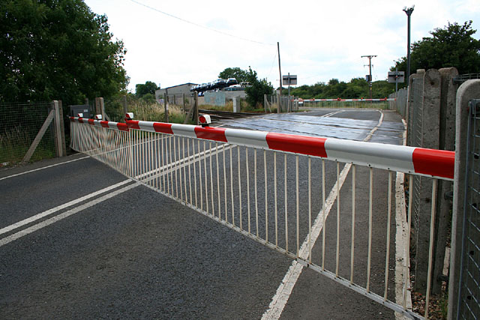
Engagement
Identify
Assess
Address
Barriers to
  Employment
  Relationships
  Self Sufficiency
  Child Support Payments

Slide 6

Case Management
Knowledge of the Child Support Program
Good Listening Skills
Empathetic
Respectful
Honest
Open
Non-Judgmental

Slide 7

Employment Resources
Express Employment Professionals-Staffing
  https://www.expresspro.com
Maryland Department of Labor
  American Job Centers
    https://dllr.state.md.us/employment
  Maryland Workforce Exchange
    https://mwejobs.maryland.gov

Slide 8



Assistance
Local Department of Social Services
  SNAP (Supplemental Nutrition Assistance Benefit)
  Medical Assistance/ Maryland Health Connection
  TCA – Temporary Cash Assistance
  TDAP - Temporary Cash Assistance for Disabled Adults without Children in Home

Slide 9


Community Partners
Behavioral Health Authorities (see handout)
Local Food Pantries
Local Churches
Cold Weather Shelters
Transitional Housing

Slide 10
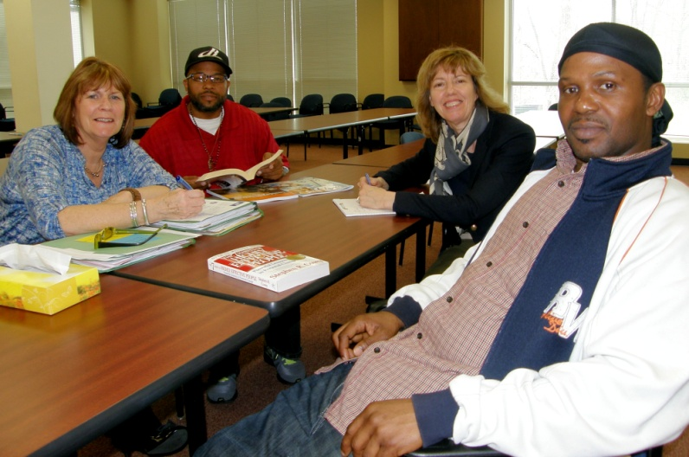
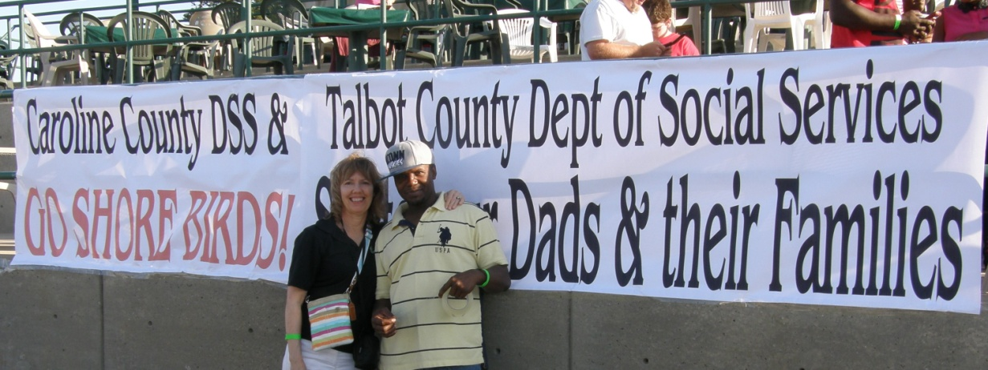


More than a Minute
It takes a Village

Slide 11



Peers Helping Peers
Chris’s Story

Slide 12
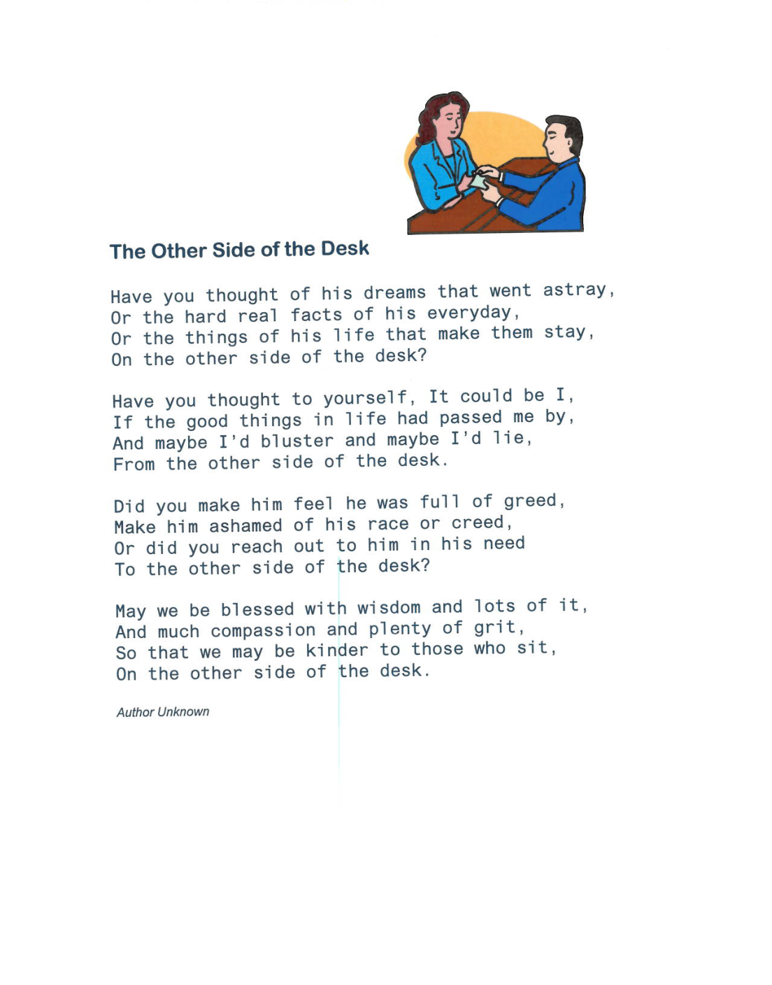
THE OTHER SIDE OF THE DESK

